Slide 1
Gurobi Implementation

Slide 2
Outlines
Introduction
Installing Gurobi
Creating a visual studio C++ project for Groubi
Building and solving Gurobi model

Slide 3
Introduction (1/4)
Gurobi is a state-of-the-art solver engine for optimization problems, including
Linear Problem (LP)
Mixed-Integer Problem (MIP)
Quadratic Problem (QP) and Mixed-Integer Quadratic Problem (MIQP) (Gurobi 4.0 and later version)
Quadratically Constrained Programming (QCP) and Mixed-Integer Quadratically Constrained Programming (MIQCP) (Gurobi 5.0 and later version)
Gurobi supports parallel computing for the modern multi-core PCs. It also offers Groubi Cloud on the Amazon Elastic Computing Cloud (EC2).

Slide 4
Introduction (2/4)
Gurobi provides different interfaces for different users:
Command line interface
Interactive Python shell
Matrix-oriented APIs: C, MATLAB ®, and R
Object-oriented APIs: C++, Java, .Net (Visual Studio), and Python.
Different modeling systems: AMPL, GAMS, AIMMS, MPL, Microsoft Solver Foundation (for Gurobi 4.5), and etc.

Slide 5
Introduction (3/4)
Groubi supports most platforms including Windows, Linux, and Mac OS X.
The platforms for Windows include
Platform: Windows 32-bit (win32) and Windows 64-bit (win64), Linux 64-bit (linux64), Mac OS 64-bit (mac64), AIX® 64-bit (power64) .
Operating System: Windows XP, Windows Vista, Windows 7, Windows 8 (Gurobi 5.1) and Windows Server 2008 R2 ®.
Complier: Visual Studio 2008 and Visual Studio 2010.

Slide 6
Introduction (4/4)
Groubi offers flexible software licensing strategies in different license types, including
Free trail license (size limited).
Commercial license.
Free academic license.
Pay-as-you-go licenses for cloud computing.
For free academic license, you need to update your license every six months, and one license only for one PC.

Slide 7
Installation

Slide 8
Installation (1/5)
Go to Gurobi’s website: http://www.gurobi.com/
Account Login >> Register for Free

Slide 9
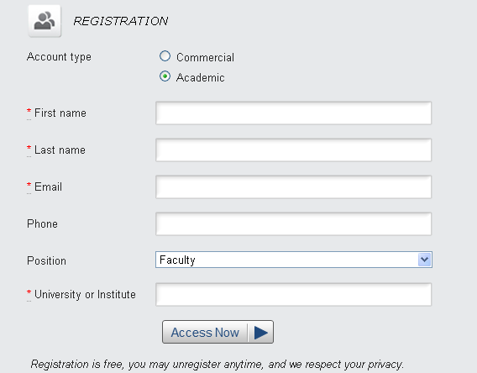
Installation (2/5)
Fill out the form and submit, then you can activate your account and get the password from e-mail.

Slide 10
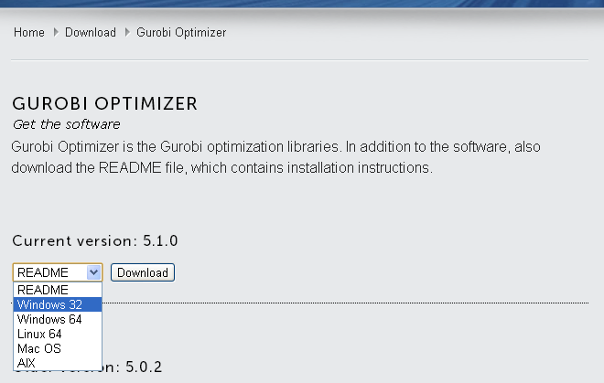
Installation (3/5)
Login your account, and Download the newest version Gurobi according to your PC’s platform.
Depending on your platform, you may choose Windows 64 for 64-bits Windows, or choose Mac OS for Macintosh.

Slide 11
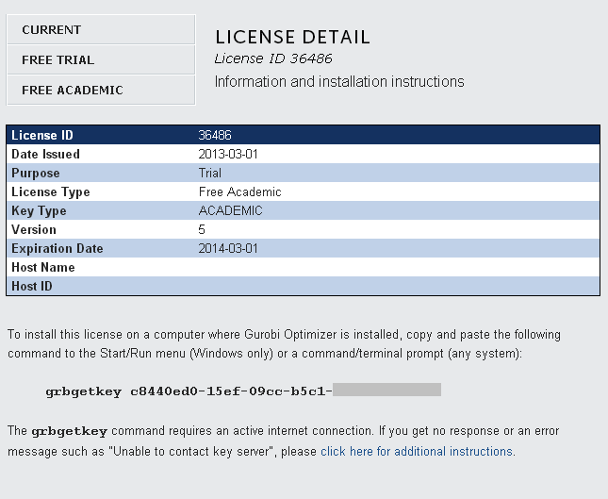
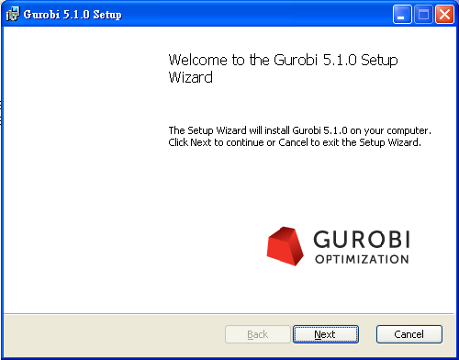
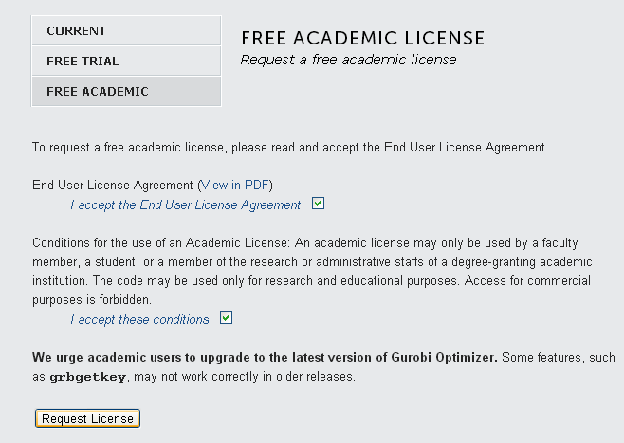
Installation (4/5)
Install the Gurobi application.
Restart the computer.
Login you Gurobi’s account, and put in for the Licenses of Free Academic.

Slide 12
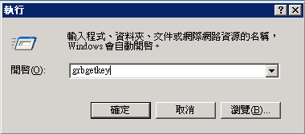
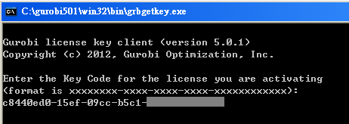
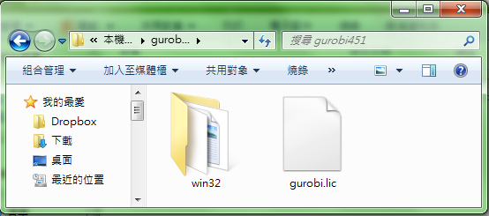
Installation (5/5)
Copy and paste grbgetkey and lincense and to the Start/Run menu (Windows only).
After downloading your gurobi.lic, put it into the Gurobi’s folder.

Slide 13
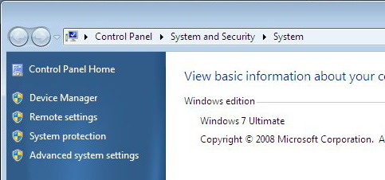
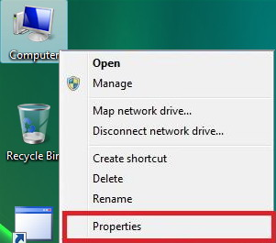
Installation [additional] (1/3)
The default location for Gurobi is in C drive (C:\gurobi). If you install Gurobi to other drives, the environment variables of Windows needs to be modified.
1) Right click on the Computer icon and choose Properties option.
2) Click on Advanced system settings in the left pane

Slide 14
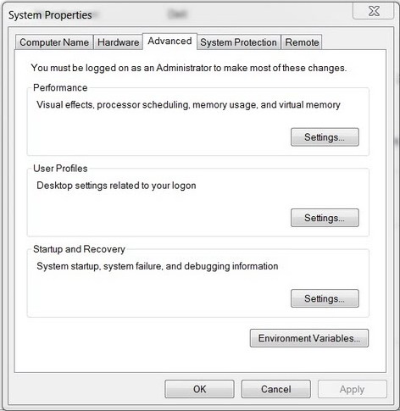
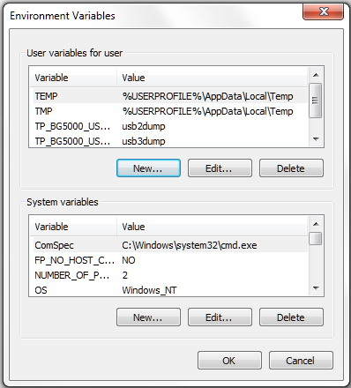
Installation [additional] (2/3)
3) Select Advanced tab and click on Environment Variables
4) Add a new User variable click on New button.

Slide 15
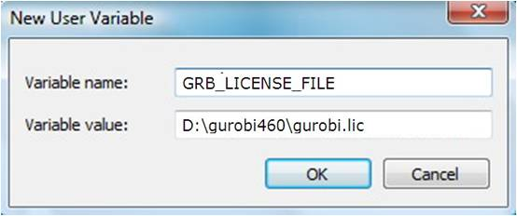
Installation [additional] (3/3)
5) Give Variable name = GRB_LICENSE_FILE
and Variable value = Z:\gurobi460\gurobi.lic (location of the file)
6) Restart your Visual Studio!

Slide 16
Creating Visual C++ Project

Slide 17
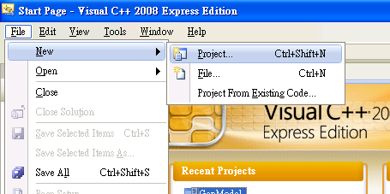
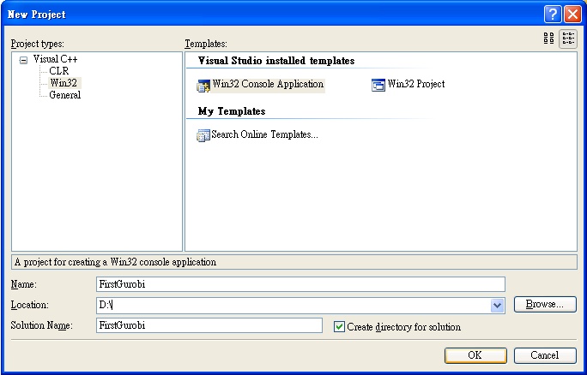
Creating Visual C++ Project (1/9)
Choose Win32 Console Application
(Win32主控台應用程式)

Slide 18
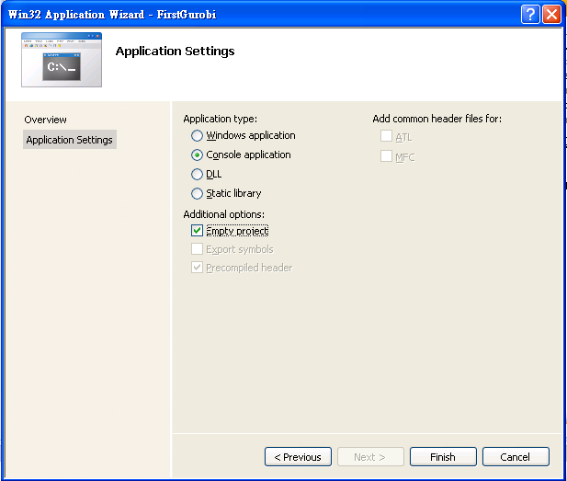
Creating Visual C++ Project (2/9)
Check Empty Project

Slide 19
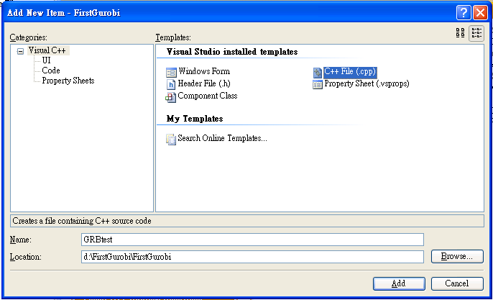
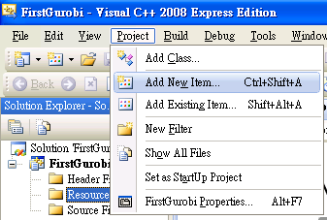
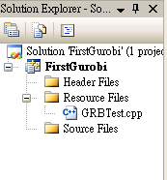
Creating Visual C++ Project (3/9)
If the CPP file exists, then select "Add Existing Item"
Otherwise, create a new CPP file by selecting "Add New Item"

Slide 20
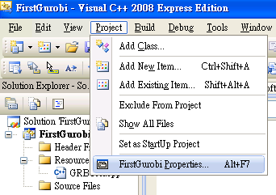
Creating Visual C++ Project (4/9)

Slide 21
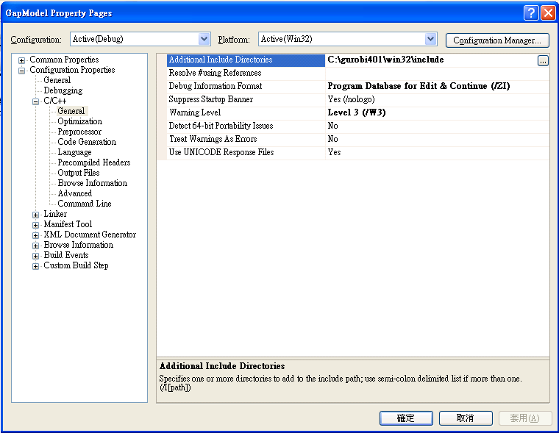
Creating Visual C++ Project (5/9)
The directory should be modified according to the version of Gurobi you installed. Currently the newest version should be C:\gurobi501\win32\include

Slide 22
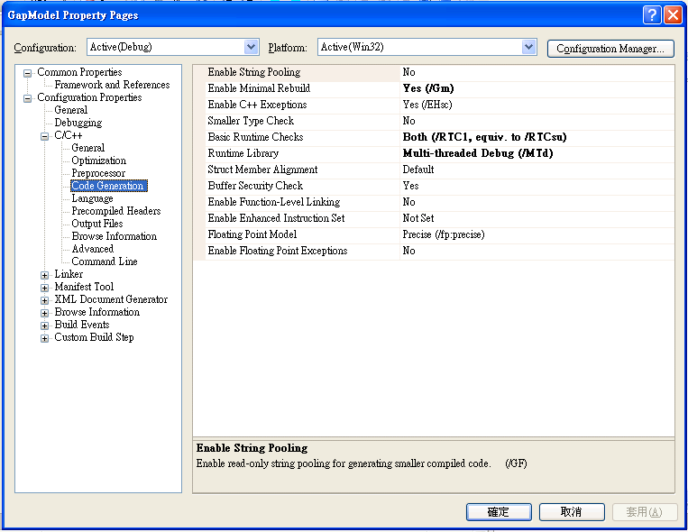
Creating Visual C++ Project (6/9)
Multi-threaded Debug (/MTd)

Slide 23
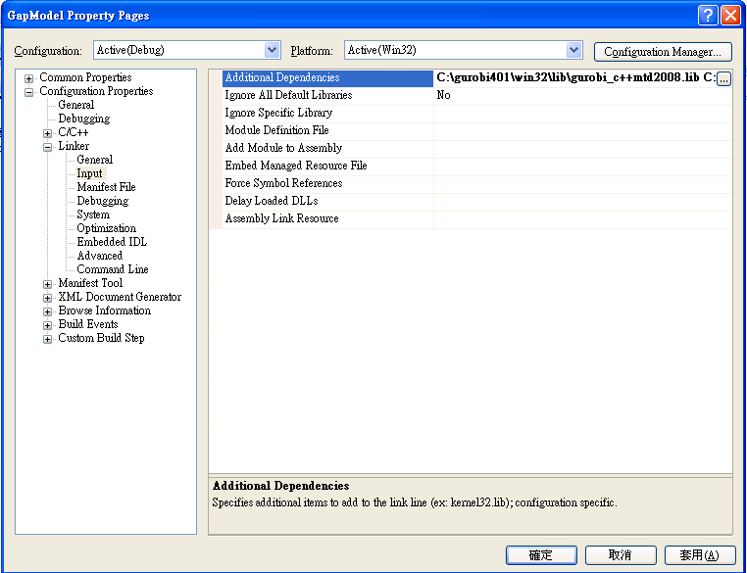
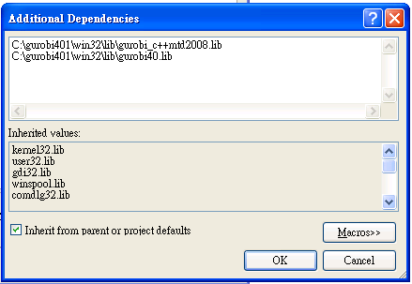
Creating Visual C++ Project (7/9)
Depending on the version of your Gurobi and Visual Studio. For example , if you use 2010, then the first line should be C:\gurobi501\win32\lib\gurobi_c++mtd2010.lib

Slide 24
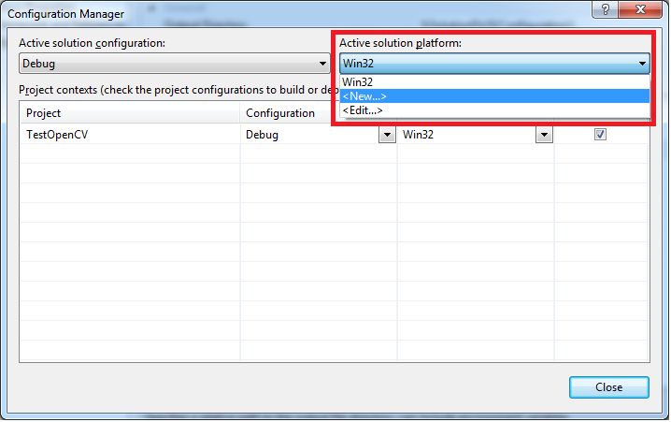
Creating Visual C++ Project [64-bits] (8/9)
For 64-bits Gurobi libraries, Active solution platform has to be modified for 64-bits environment.
Press the Configuration Manager... button. Under Active solution platform, select New.

Slide 25
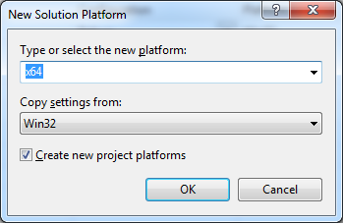
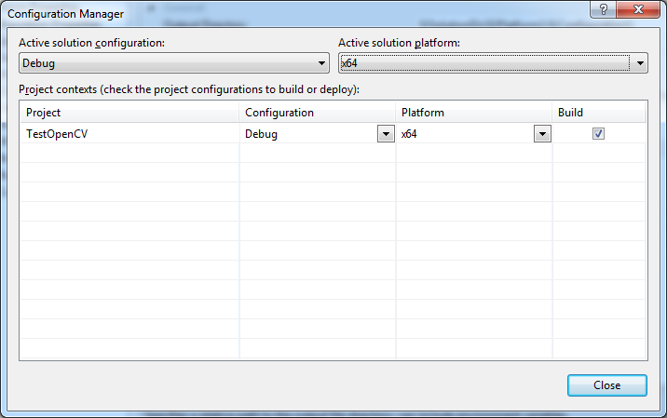
Creating Visual C++ Project [64-bits] (9/9)
Set the new platform to x64, and press OK.

Slide 26
Linear Programming – Example 1

Slide 27
Linear Programming – Example 1
YZ Co. produces clay bowls and pots with aboriginal designs and colors. The two primary resources used by the company are skilled and special pottery clay. The two products have the following resource requirements for production and profit per item:
Product | Labor (hr/unit) | Clay (lb/unit) | Profit ($/unit)
Bowl | 1 | 4 | 40
Pot | 2 | 3 | 50
Available | 40 | 120

Slide 28
An Example
Product | Labor (hr/unit) | Clay (lb/unit) | Profit ($/unit)
Bowl | 1 | 4 | 40
Pot | 2 | 3 | 50
Available | 40 | 120
Decision variables：
X1 : number of bowls to produce
X2 : number of pots to produce
Objective function：Max Z = 40X1+50X2
Constraints：
X1 | + | 2X2 | ≤ | 40
4X1 | + | 3X2 | ≤ | 120
X1 |  |  | ≥ | 0
 |  | X2 | ≥ | 0

Slide 29
8 elements for Gurobi model
Basic Elements
Decision Variables
Lazy Update
Constraint
Objective Function
Optimization
Check Optimality and Output Results
Exception Handling

Slide 30
Linear Programming – model
Product | Labor (hr/unit) | Clay (lb/unit) | Profit ($/unit)
Bowl | 1 | 4 | 40
Pot | 2 | 3 | 50
Available | 40 | 120
Decision variables：
X1 : number of bowls to produce
X2 : number of pots to produce
Objective function：Max Z = 40X1+50X2
Constraints：
1.Prarmeters
1X1 | + | 2X2 | ≤ | 40
4X1 | + | 3X2 | ≤ | 120
X1 |  |  | ≥ | 0
 |  | X2 | ≥ | 0
2. Decition Variables
3. Constraints
4. Objective

Slide 31
1. Basic Elements – Gurobi Objects (1/2)
Environment Object - GRBEnv()
GRBEnv EnvName = GRBEnv();
Model Object - GRBModel (const GRBEnv& env)
GRBModel ModelName= GRBModel (EnvName);
The words in blue is the Gurobi’s identifier
The words in orange is the variable identifier that can be named by yourself
//1.1 Basic elements declaration
GRBEnv env = GRBEnv();
GRBModel model = GRBModel(env);

Slide 32
1. Basic Elements – Parameters (2/2)
Give known parameters and coefficients by declaring a matrix or reading data from a file.
//1.2 Parameters definition
const int N = 2; //number of resources
const int M = 2; //number of products (D.V.)
int a[N][M]= {{1, 2},
{4, 3}}; //coefficients in the constraints
int b[N] = {40, 120}; //coefficients of the RHS (Right-Hand-Side)
int c[M] = {40, 50}; //coefficients of objective function

Slide 33
2. Decision Variable Declarations (1/2)
GRBVar VarName = ModelName.addVar(lb, ub, obj, type);
lb : Lower bound for the variable
ub : Upper bound for the variable (If the upper bound is unlimited, then ub is given to GRB_INFINITY)
obj : Objective coefficient for the variable.
type: GRB_INTEGER – Integer variable
GRB_BINARY – Binary variable (0 or 1)
GRB_CONTINUOUS – Continuous variable
GRB_SEMICONT – Semi-continuous variable (Ex: x=0 or 2≤x ≤4 )
GRB_SEMIINT – Semi-integer variable

Slide 34
2. Decision Variable Declarations (2/2)
//2. Decision Variables
GRBVar x[M];
for(int j=0; j<M; j++) {
x[j] = model.addVar(0.0, GRB_INFINITY, 0.0, GRB_CONTINUOUS);
}
The objective coefficients can be set to arbitrary value, and the true values are given later.

Slide 35
3. Lazy Update
Groubi update model in batch mode, so model must be updated after adding variables into the model
ModelName.update();
//3. Integrate variables into model
model.update();

Slide 36
4.Constraint Declaration (1/2)
GRBLinExpr Linexpr = 0;
ModelName.addConstr(lhsExpr, sense, rhsExpr);
lhsExpr : Left-hand side (LHS) expression for new linear constraint.
sense : GRB_LESS_EQUAL – LHS is less than and equal to RHS (<=).
GRB_EQUAL – LHS is equal to RHS (==).
GRB_GREATER_EQUAL – LHS is greater than and equal to RHS (>=).
rhsExpr : Right-hand side (RHS) expression for new linear constraint.
ModelName.addConstr(GRBTempConstr& tc);

Slide 37
4.Constraint Declaration (2/2)
Original:
General Form:
1X1 | + | 2X2 | ≤ | 40
4X1 | + | 3X2 | ≤ | 120
//4. Constraint Declaration
for(int i=0; i<N; i++) {
GRBLinExpr LHS=0;
for(int j=0; j<M; j++) {
LHS += a[i][j]*x[j];
}
model.addConstr(LHS,GRB_LESS_EQUAL,b[i]);
}

Slide 38
5. Objective Function
ModelName.set(GRB_IntAttr_ModelSense, sense);
sense =
ModelName.setObjective(GRBLinExpr or GRBQuadExpr);
GRBQuadExpr is the quadratic expression.
1 : Minimization (default )
-1 : Maximization
//5. set the model to maximization
model.set(GRB_IntAttr_ModelSense, -1);
GRBLinExpr Obj = 0;
for(int j=0; j<M; j++)
Obj += c[j]*x[j];
model.setObjective(Obj);
Original:
General Form:
Max Z = 40X1+50X2
Max Z =

Slide 39
6.Optimization
ModelName.optimize ();
//6. Optimize the model
model.optimize();

Slide 40
7. Check Optimality and Output Results
7.1 Check Optimality
Get optimality status: int status = ModelName.get(GRB_IntAttr_Status);
Status types include GRB_OPTIMAL, GRB_INF_OR_UNBD, GRB_INFEASIBLE, GRB_UNBOUNDED, etc.
//7.1 Check optimality
int status = model.get(GRB_IntAttr_Status);
if (status == GRB_OPTIMAL) {
//7.2 Output the objective value and solutions
} else if (status == GRB_INF_OR_UNBD) {
cout << "Infeasible or unbounded" << endl;
} else if (status == GRB_INFEASIBLE) {
cout << “Infeasible" << endl;
} else if(status == GRB_UNBOUNDED) {
cout << “Uunbounded" << endl;
} else {
cout << "Optimization was stopped with status" << status << endl;
}

Slide 41
7. Check Optimality and Output Results
7.2 Output Results
Get objective value:
ModelName.get(GRB_DoubleAttr_ObjVal);
Get solution value:
VarName.get(GRB_DoubleAttr_X);
//7.2 Output the objective value and solutions
double ObjValue = model.get(GRB_DoubleAttr_ObjVal);
cout<<“total cost= "<<ObjValue<<endl;
for(int i=0; i<M; i++) {
cout<<"x "<<i<<" =“<<x[i].get(GRB_DoubleAttr_X)<<endl;
}

Slide 42
8. Exception Handling
Using exception handling to show unexpected errors of Gurobi.
Put the following code into the main function to wrap previously mentioned steps.
//8 Output the objective value and solutions
int main() {
try {
// Step 1 to step 7 …
} catch(GRBException e) {
cout << "Error code = " << e.getErrorCode() << endl;
cout << e.getMessage() << endl;
} catch(...) {
cout << "Exception during optimization" << endl;
}
}

Slide 43
Comparing Different Forms
General Form
Expression Form
//2. Decision Variables
GRBVar x[M];
for(int j=0; j<M; j++)
x[j] = model.addVar(0.0, GRB_INFINITY, 0.0, GRB_CONTINUOUS);
model.update(); //3. Integrate variables into model
//4. Constraint Declaration
for(int i=0; i<N; i++) {
GRBLinExpr LHS=0;
for(int j=0; j<N; j++) {
LHS += a[i][j]*x[j];
}
model.addConstr(LHS <= b[i]);
}
//5. set the model to maximization
model.set(GRB_IntAttr_ModelSense, -1);
GRBLinExpr Obj = 0;
for(int j=0; j<M; j++)
Obj += c[j]*x[j];
model.setObjective(Obj);
//2. Decision Variables
GRBVar x1, x2;
x1= model.addVar(0.0, GRB_INFINITY, 0.0, GRB_CONTINUOUS);
x2 = model.addVar(0.0, GRB_INFINITY, 0.0, GRB_CONTINUOUS);
//3. Integrate variables into model
model.update();
//4. Constraint Declaration
model.addConstr(1*x1 + 2*x2 <= 40);
model.addConstr(4*x1 + 3*x2 <= 120);
//5. set the model to maximization
model.set(GRB_IntAttr_ModelSense, -1);
model.setObjective(40*x1+50*x2);

Slide 44
Parameter Setting

Slide 45
Parameters (1/3) - Time limitation
GRBEnv EnvName = ModelName.getEnv();
ModelName.set(GRB_DoubleParam_ TimeLimit, time);
memory: Limit the total time expended (in seconds).
//6. Optimize the model
GRBEnv modelEnv = model.getEnv();
modelEnv.set(GRB_DoubleParam _ TimeLimit, 3600.0);
model.optimize();

Slide 46
Parameters (2/3) - Gap
GRBEnv EnvName = ModelName.getEnv();
ModelName.set(GRB_DoubleParam_ MIPGap, gap);
gap : The MIP solver will terminate (with an optimal result) when the relative gap between the lower and upper objective bound is less than MIPGap times the upper bound
//6. Optimize the model
GRBEnv modelEnv = model.getEnv();
modelEnv.set(GRB_DoubleParam _ TimeLimit, 3600.0);
model.optimize();

Slide 47
Parameters (3/3) - Reducing Memory Usage
GRBEnv EnvName = ModelName.getEnv();
EnvName.set(GRB_DoubleParam_NodefileStart, memory);
EnvName.set(GRB_StringParam_NodefileDir, path);
memory: Controls the point at which MIP tree nodes are written to disk. Whenever node storage exceeds the specified value (in GBytes), nodes are written to disk.
path: Determines the directory into which nodes are written when node memory usage exceeds the specified NodefileStart value.
Note: this is much more efficient than relying on virtual memory !!
//6. Optimize the model
GRBEnv modelEnv = model.getEnv();
modelEnv.set(GRB_DoubleParam_NodefileStart,0.1);
modelEnv.set(GRB_StringParam_NodefileDir,"G://GRBStore");
model.optimize();

Slide 48
Attributes (1/1) – Runtime and Bound
Obtain the solving time (in seconds) for most recent optimization.
ModelName.get(GRB_DoubleAttr_Runtime);
double Runtime = model.get(GRB_DoubleAttr_Runtime);
Obtain the best bound on current solution (lower bound for minimization, upper bound for maximization).
ModelName.get(GRB_DoubleAttr_ObjBound);
double bound = model.get(GRB_DoubleAttr_ObjBound);
//7.Output the elapsed time
double Runtime = model.get(GRB_DoubleAttr_Runtime);
cout<<“elapsed time= "<< Runtime <<endl;
//7.Output the lower bound (minimization problem)
double LBound = model.get(GRB_DoubleAttr_ObjBound);
cout<<“lower bound= "<< LBound <<endl;

Slide 49
More Information
Attributes for model, variable, constraints, etc:
http://www.gurobi.com/doc/40/refman/node571.html#sec:Attributes
Parameters for solving scheme:
http://www.gurobi.com/doc/40/refman/node572.html#sec:Parameters
Status codes for optimization:
http://www.gurobi.com/doc/40/refman/node576.html#sec:StatusCodes

